Slide 1
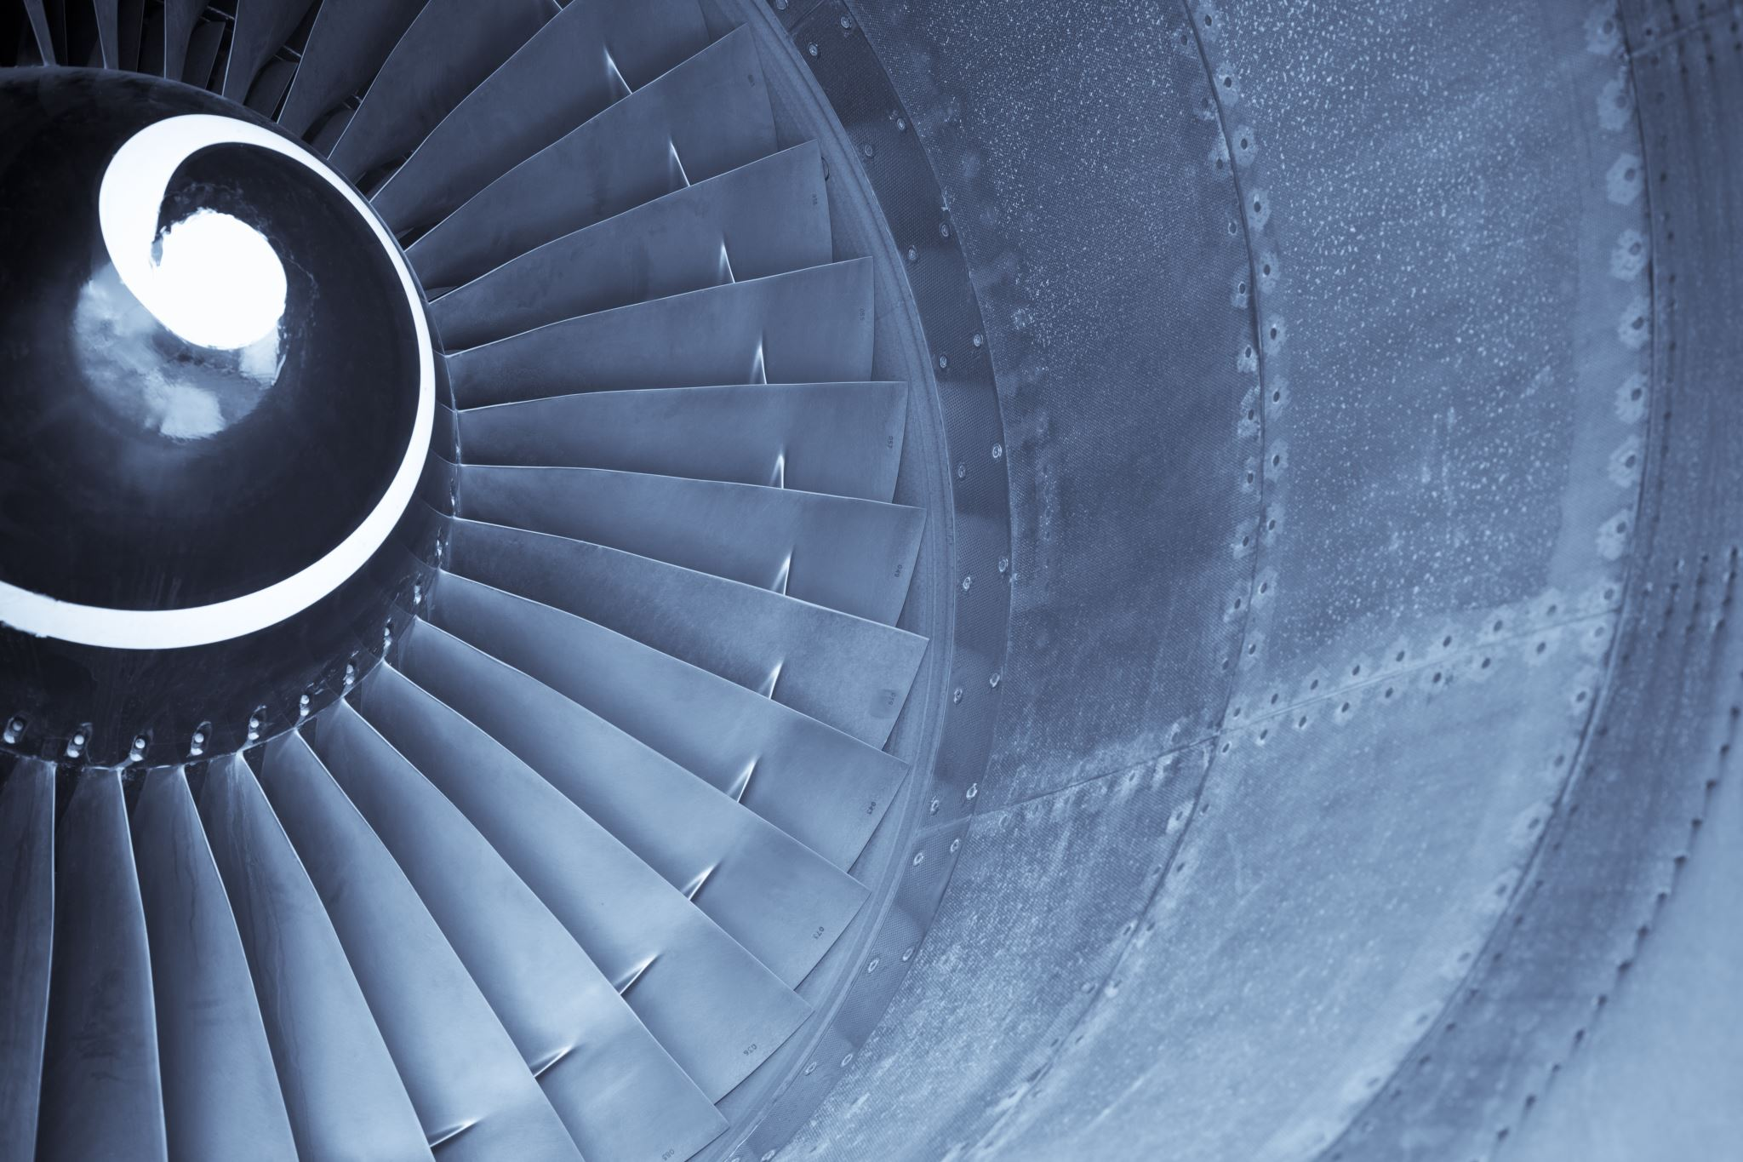

Airline Ticket Reissue
COSC 498 – Capstone
Donna Dearing
Notes:
Hello, I’m Donna Dearing, and my Capstone Project is about Airline Ticket Reissue.

Slide 2
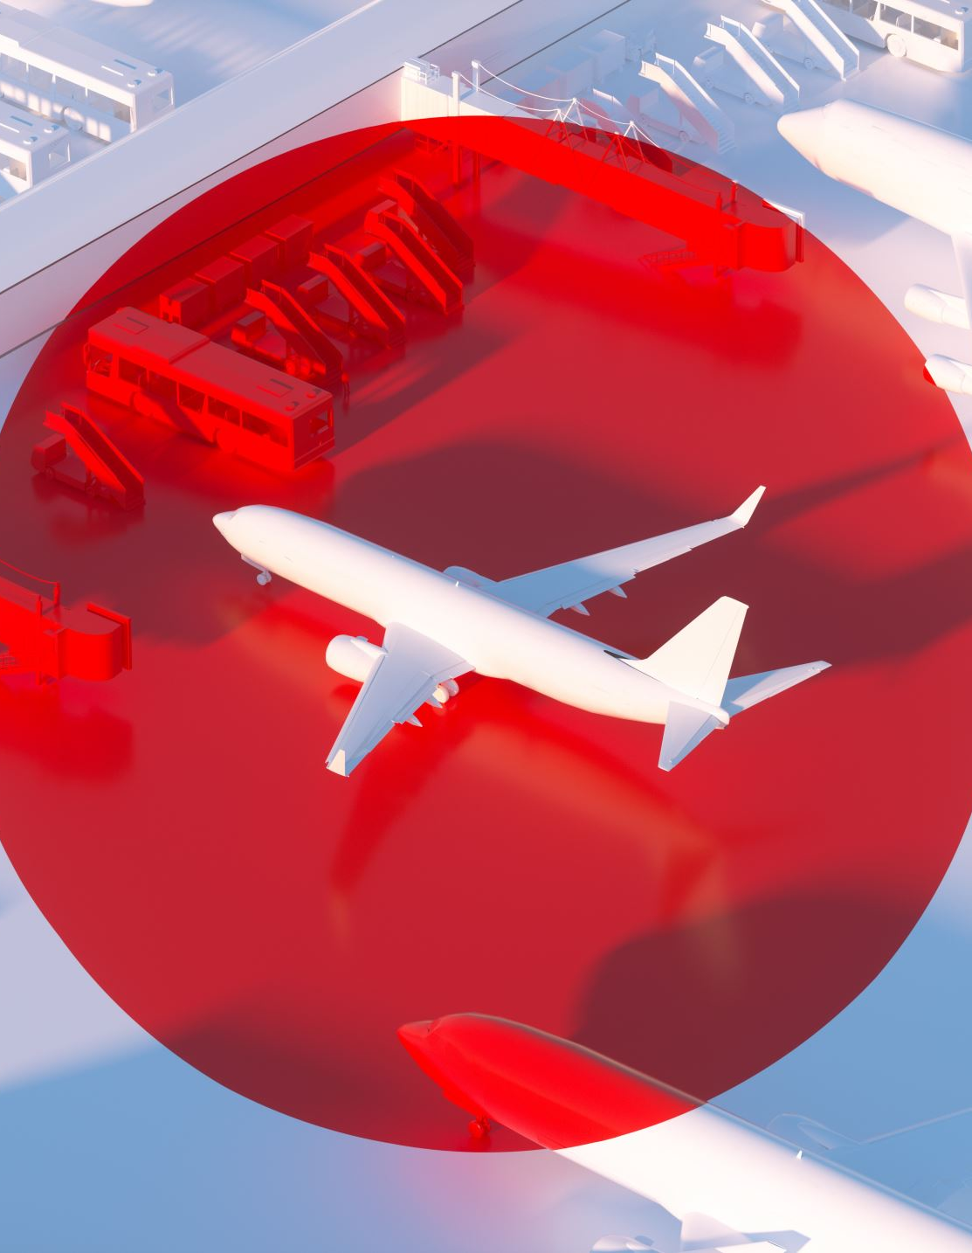
Introduction
This project concerns a solution for printing unnecessary ticket stock when an airline ticket must be reissued.
When an American Airlines (AA) passenger changes their ticket, whether voluntary or involuntary, the AA Agent must reissue the original ticket to reflect the change.
Otherwise, the passenger will not be able to check-in for that flight to obtain their boarding pass.
Only an AA Agent can reissue an airline ticket; passenger cannot reissue their ticket.
Notes:
Let me explain. When an AA psgr chgs their itin, whether vol or involuntary, the agent must reissue the tkt, otherwise the psgr cannot ck-in and obtain their boarding pass. Only and Agent can reissue, not a psgr.

Slide 3
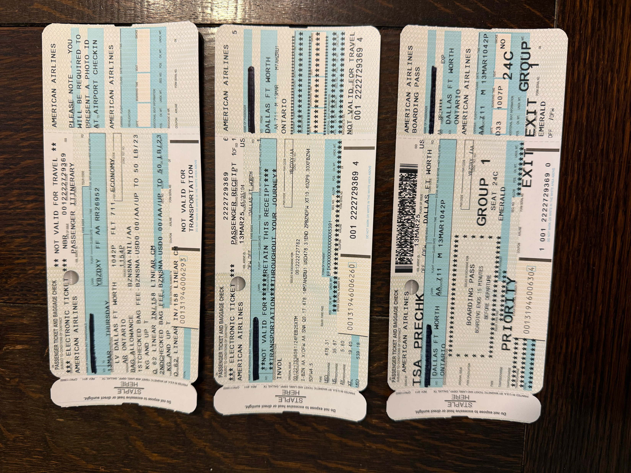
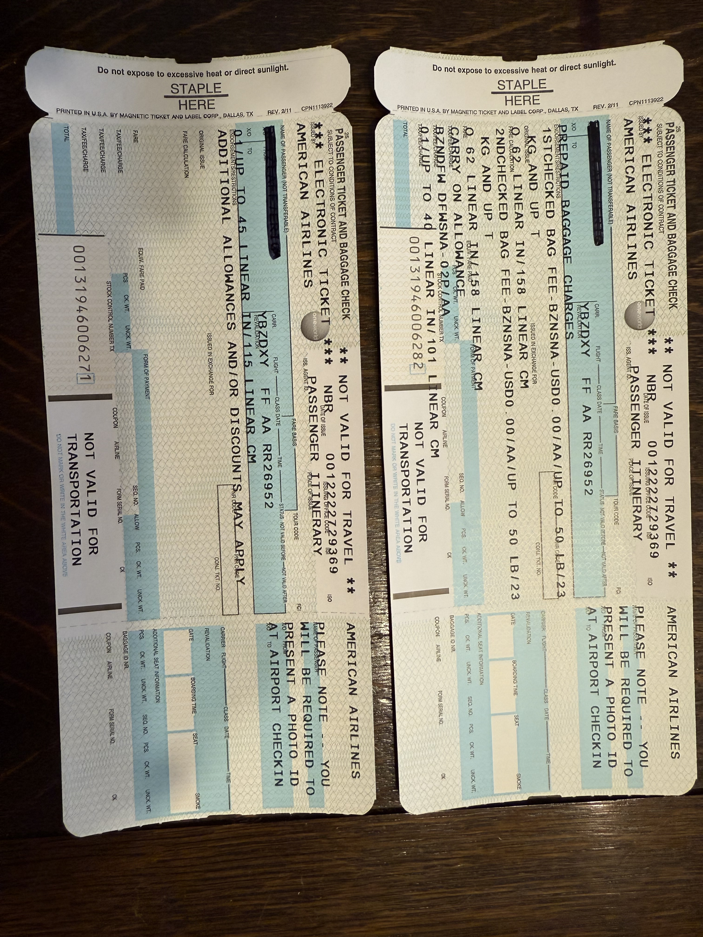
Unneeded Ticket Stock
#1-Itinerary, #2-Fare Info, #3-Boarding Pass
Notes:
On the left side we have a copy of the passenger’s itinerary, the fare information and the boarding pass, which is all we need. On the right side we have print outs that are not needed, such as baggage rules.

Slide 4
User Persona
During irregular operations (IROPS), where flights are delayed or canceled, a ticket sometimes must be reissued if the passenger must change their flight.
User Problem-Solving
Current programming must be changed to eliminate the coding that prints the unneeded ticket stock items.
This change would save ticket stock costs because fewer pages would be printed.
User Interaction
Saving passengers' time, the agent's time, and the company's money would justify this implementation.
Notes:
The User Persona is: User Problem-Solving involves changing or eliminating the code to not print out unnecessary items after the ticket exchange. User Interaction will be saving the psgrs time, the agents time and the company’s money clearly justifies this implementation.

